Slide 1
21AIE401 DEEP REINFORCEMENT LEARNING FOR FLAPPY BIRD GAME

Slide 2
C Satyananth
01
K V Sai Krishna
Team - 8
02
P Sri Vaishno
03
CB.EN.U4AIE19019
CB.EN.U4AIE19035
CB.EN.U4AIE19048

Slide 3
Introduction
Background
TABLE OF CONTENTS
Implementation
Flappy Bird Model and Results

Slide 4
Introduction
Deep Reinforcement Learning is the combination of Reinforcement Learning with Deep Learning techniques to solve challenging sequential decision-making problems. The use of deep learning is most useful in problems with high-dimensional state space. This means, that with deep learning, Reinforcement Learning is able to solve more complicated tasks with lower prior knowledge because of its ability to learn different levels of abstractions from data.

Slide 5
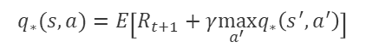
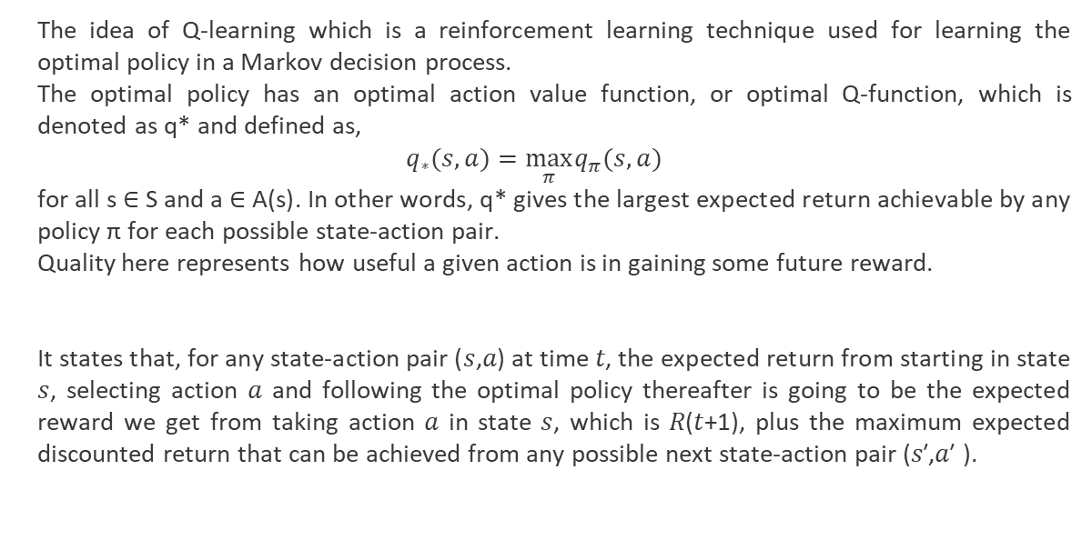
What is Q Learning?
The idea of Q-learning which is a reinforcement learning technique used for learning the optimal policy in a Markov decision process.
The optimal policy has an optimal action value function, or optimal Q-function, which is denoted as q* and defined as,
$$q_{∗}(s,a)=\max_{π} q_{π}(s,a)$$
for all s ∈ S and a ∈ A(s). In other words, q* gives the largest expected return achievable by any policy π for each possible state-action pair.
Quality here represents how useful a given action is in gaining some future reward.
It states that, for any state-action pair (𝑠,𝑎) at time 𝑡, the expected return from starting in state 𝑠, selecting action 𝑎 and following the optimal policy thereafter is going to be the expected reward we get from taking action 𝑎 in state 𝑠, which is 𝑅(𝑡+1), plus the maximum expected discounted return that can be achieved from any possible next state-action pair (𝑠′,𝑎′ ).
$$q_{∗}(s,a)=E\left[R_{t+1}+γ\max_{a^{′}} q_{∗}\left(s^{′},a^{′}\right)\right]$$

Slide 6
Q-Function and Update
The Temporal difference is an agent learning from an environment through episodes with no prior knowledge of the environment.
The Q-learning algorithm iteratively updates the Q values for each state action pair using the bellman equation until the Q-function converges to the optimal Q function q*. This iterative approach is called value iteration.
$$Q^{π}\left(s_{t},a_{t}\right)=E\left[R_{t+1}+γR_{t+2}+γ^{2}R_{t+3}+…∣s_{t},a_{t}\right]$$

Slide 7
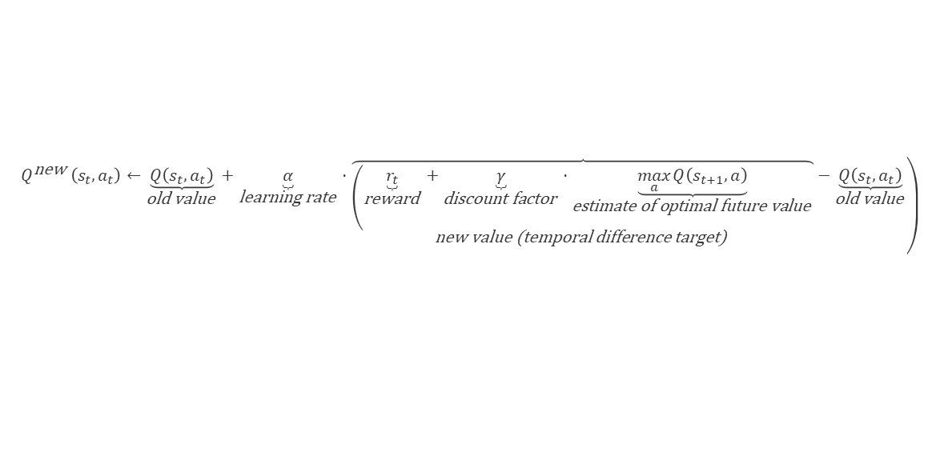
Q-Function and Update
The agent maintains a table of Q[S, A], where S is the set of states and A is the set of actions called the Q-Table, which is the data structure used to calculate the maximum expected future rewards for action at each state. Basically, this table will guide us to the best action at each state. To learn each value of the Q-table, Q-Learning algorithm is used. Q[s, a] represents its current estimate of Q*(s, a).
$$\left.Q^{\text{new} }\left(s_{t},a_{t}\right)←\underset{\text{old} \text{value} }{\underbrace{Q\left(s_{t},a_{t}\right)}}+\underset{\text{learning} \text{rate} }{\underbrace{α}}⋅\underset{\text{new} \text{value}\text{ (}\text{temporal} \text{difference} \text{target}\text{) }}{\overbrace{\left(\underset{\text{reward} }{\underbrace{r_{t}}}+\underset{\text{discount} \text{factor} }{\underbrace{γ}}⋅\underset{\text{estimate} \text{of} \text{optimal} \text{future} \text{value} }{\underbrace{\max_{a} Q\left(s_{t+1},a\right)}}\right.}}−\underset{\text{old} \text{value} }{\underbrace{Q\left(s_{t},a_{t}\right)}}\right)$$

Slide 8
Epsilon Greedy Algorithm
Epsilon-Greedy is a simple method to balance exploration and exploitation by choosing between exploration and exploitation randomly.
The epsilon-greedy, where epsilon refers to the probability of choosing to explore, exploits most of the time with a small chance of exploring.
The greedy-mechanism can help the agent focus on its currently most “successful” bandits, and the exploratory-mechanism gives the agent to explore for better bandits that might be out there.
Action at $t=\left\{\begin{matrix}maxQ_{t}(a), \text{with} \text{probability} 1−ε \\ \text{random} \text{action} \text{a}\text{ , }\text{with} \text{probability} ε\end{matrix}\right\}$

Slide 9
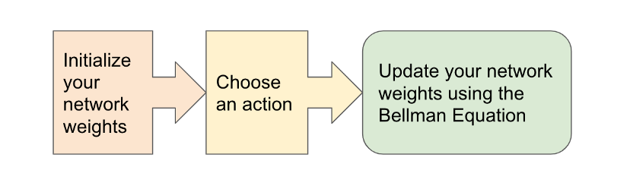
Deep Q Network
A Neural Network maps input states to (action, Q-value) pairs
1. Initialize your Main and Target neural networks
2. Choose an action using the Epsilon-Greedy Exploration Strategy
3. Update your network weights using the Bellman Equation

Slide 10
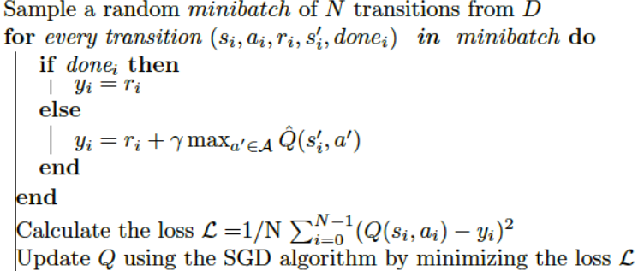
Experience Replay
Training the neural network using reinforcement learning requires a lot of data, even then, it is not guaranteed to converge on the optimal value function.
We can prevent action values from diverging using a large buffer of our past experience and sample training data from it. This technique is called replay buffer.
The act of sampling a small batch of tuples from the replay buffer in order to learn is known as experience replay.

Slide 11
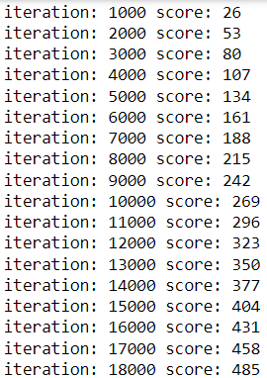
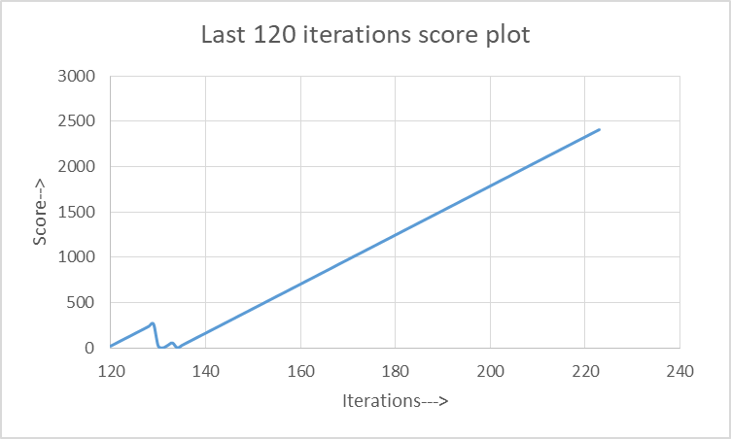
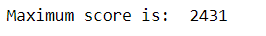
Results
DQN with random weights
training time – 14hrs with 900000 iterations
Testing time – 2hrs with 300000 iterations

Slide 12
Results
DQN with pretrained weights
Total Iterations – 500000
OBSERVE Iterations – 100000
EXPLORE Iterations – 200000
TRAIN Iterations – 200000
Score is calculated in the TRAIN iterations and resets to zero every time the bird loses.

Slide 13
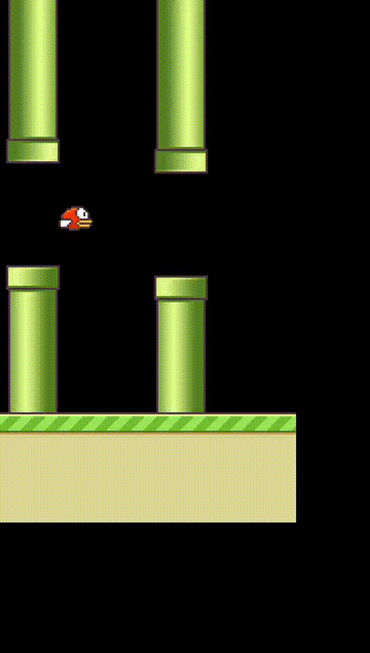
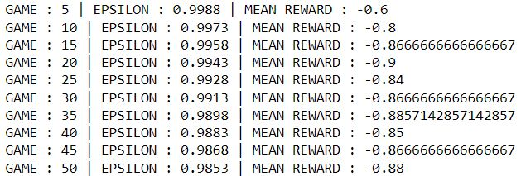
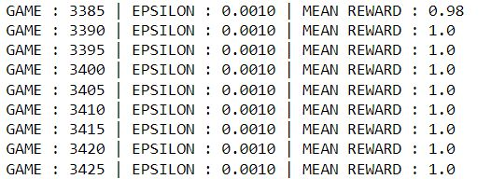
Results
DDQN using Experience Replay

Slide 14
THANK YOU

